Slide 3
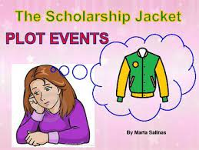
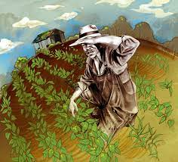
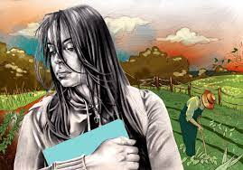

Slide 4
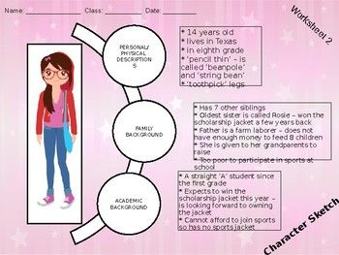

Slide 5
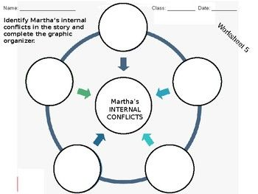

Slide 6
"The Scholarship Jacket" by Marta Salinas was first published in 1986. It tells the story of a young Mexican American girl who faces an injustice at school. It's a popular short story for students.
Summary of The Scholarship Jacket
The narrator, Martha, is nearing the end of eighth grade at her Texas school. Every year at graduation, the school awards a beautiful jacket monogrammed with an "S" and the winner's name to the class valedictorian, the student with the highest grades over eight years.
Martha's older sister Rosie won it years earlier. Martha is going to win it this year.
She lives with her grandparents. Her parents couldn't afford to raise all their kids. Martha is very thin. She's not happy with her appearance but she's smart.

Slide 7
An Overheard Conversation
One day at the end of the school year, Martha has to go back to her classroom to get her shorts for gym class. Hearing raised voices inside, she stops outside the door. Two of her teachers are arguing about her. She's shocked and stands there listening.
Mr. Schmidt is saying he refuses to do something, that it doesn't matter who her father is, and that Martha is the clear winner. Mr. Boone says Joann's father is on the Board, owns the only store in town, and that they could make some excuse. She also hears mention of her Mexican background and a threat to resign.
Mr. Schmidt storms out but doesn't notice Martha. She waits until she calms down and goes into the classroom to get her bag. She can't remember the rest of the day.

Slide 8
Martha Tells Her Grandpa
Martha cries quietly that night.
The next day, she's called to the principal's office. He looks uncomfortable. He tells Martha the policy has changed this year—there will now be a $15 charge for the scholarship jacket. If she can't pay, the next in line will get the jacket.
She says she'll tell her grandfather and get back to him. She cries on the way home.
Martha goes into the bean field to find her Grandpa. She explains the situation. He asks what the scholarship jacket means. She says it's given to the student who earns it. They both understand. Before she leaves he says if it's paid for it's not a scholarship jacket.

Slide 9
Martha Tells Her Grandpa
Martha cries quietly that night.
The next day, she's called to the principal's office. He looks uncomfortable. He tells Martha the policy has changed this year—there will now be a $15 charge for the scholarship jacket. If she can't pay, the next in line will get the jacket.
She says she'll tell her grandfather and get back to him. She cries on the way home.
Martha goes into the bean field to find her Grandpa. She explains the situation. He asks what the scholarship jacket means. She says it's given to the student who earns it. They both understand. Before she leaves he says if it's paid for it's not a scholarship jacket.

Slide 10
Martha Will Get the Jacket
She's angry but knows Grandpa is right.
Martha is sad the next day when she goes to see the principal. She tells him her grandfather won't pay. He asks why, because he has enough money. She explains the reason. She adds that they'll have to give the jacket to Joann.
The principal stops her before she leaves. He says they'll make an exception and give her the jacket. Martha is very happy and thanks him.
When she sees Mr. Schmidt later he acknowledges her accomplishment. She hugs him.

Slide 11
Martha Celebrates
Martha cries with happiness on the way home. She rushes to the field to tell her grandfather. She ends up working with him a few minutes first, then gives him the good news.
He pats her on the shoulder and wipes the sweat off his forehead. He tells her to see if her grandmother needs help with supper.
Martha smiles at him. She's not fooled. She runs happily to the house.
Theme: Standing Up for What's Right
There are three characters who take a principled stand for what is right—Mr. Schmidt, Grandpa and finally, Martha.
We first learn of the plot against Martha when she overhears the argument between Mr. Schmidt and Mr. Boone. Mr. Schmidt is adamant in his refusal to cheat Martha out of her prize. He doesn't care who Joann's father is. He recognizes the injustice of trying to take what Martha earned because she's an easy target, being Mexican and from a poor family. He threatens to resign over it.

Slide 12
Grandpa's Wisdom
The next character who recognizes the greater issue is Grandpa. He points it out to Martha by asking her about the significance of the scholarship jacket—it's earned and it's given. The question isn't whether he can pay the money or not, it's whether it should be paid at all.
The answer is no. Paying for the scholarship jacket goes against everything it represents. Paying for the jacket wouldn't right the wrong that is being done.
Martha Understands
At first, Martha doesn't understand the larger principle at play here. When she tells Grandpa she's in danger of losing her prize, she's "desperately hoping he'd say [she] could have the money." On the surface, this makes sense. She's earned this prize and doesn't want to see it go to someone else. After the conversation with Grandpa, she knows he's right. She's still angry and sad, but she understands that paying for something that's been earned doesn't make sense.

Slide 13
Graphic organizer link
https://prezi.com/cjddku1s8hhd/the-scholarship-jacket-plot-structure/
YouTube link
https://www.youtube.com/watch?v=-rEHcNgVk6M&t=18s&pp=ygUWdGhlIHNjaG9sYXJzaGlwIGphY2tldA%3D%3D

